Slide 1

Credit Card Fraud Detection
Leveraging Machine Learning for Financial Security
Presented by: CODE CRAFTERS
1. Sahana. bshettar
2. Vidya.M.B
3. Monika. H.B
4. Madhushri. S.V
5. Anusha.G.M

Slide 2

Introduction to Credit Card Fraud
Credit card fraud is a significant global concern, leading to billions in losses annually for consumers and financial institutions. It involves unauthorized use of credit card information to make purchases or access funds.
Rapidly evolving tactics used by fraudsters necessitate robust detection systems.
Effective fraud detection is crucial for maintaining consumer trust and financial stability.
Machine learning offers a powerful approach to identify suspicious patterns in real-time transactions.

Slide 3
The Problem: Challenges in Detection
1
2
3
Imbalanced Data
Dynamic Fraud Patterns
Real-time Processing
Fraudulent transactions are rare compared to legitimate ones, leading to biased models.
Fraudsters constantly adapt, requiring models to evolve and learn new patterns.
Detection must occur instantly to prevent transactions from being completed.
4
Feature Engineering
Identifying relevant transaction features that distinguish fraud from legitimate activity.

Slide 4

Dataset Description: Unveiling Transaction Data
Our project utilizes a publicly available dataset from Kaggle, comprising credit card transactions.
Source: European credit card transactions.
Size: Approximately 284,807 transactions.
Features: 30 numerical features (V1-V28) obtained via PCA transformation, 'Time' and 'Amount'.
Class Labels: Binary classification: '0' for legitimate, '1' for fraudulent.
Imbalance: Only 0.172% of transactions are fraudulent, highlighting the class imbalance challenge.

Slide 5
Data Preprocessing: Preparing for Analysis
01
02
Data Cleaning & Outlier Treatment
Feature Scaling
Addressing missing values and anomalous data points to improve model robustness.
Standardizing numerical features ('Time' and 'Amount') to ensure fair contribution to model training, using StandardScaler.
03
04
Handling Imbalanced Data
Train-Test Split
Employing techniques like SMOTE (Synthetic Minority Over-sampling Technique) to create synthetic samples for the minority class, mitigating bias.
Dividing the dataset into training and testing sets to evaluate model performance on unseen data.

Slide 6

Model Algorithms: Detecting Fraud
Decision Tree Classifier
Random Forest Classifier
A tree-based model that makes decisions based on feature values, interpretable and effective for classification tasks.
An ensemble method leveraging multiple decision trees to improve accuracy and reduce overfitting.
Logistic Regression
Support Vector Machine (SVM)
A statistical model that predicts the probability of a binary outcome, often used as a baseline for classification.
A powerful algorithm for classification that finds an optimal hyperplane to separate data points.

Slide 7
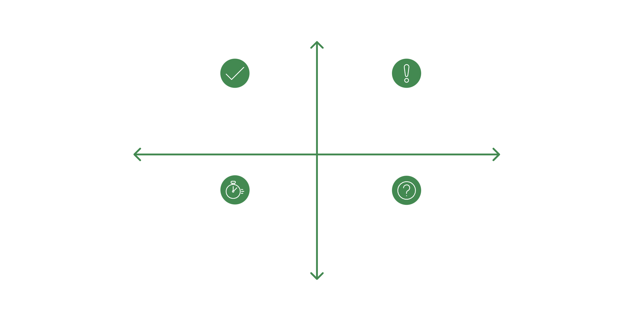
Evaluation Metrics: Measuring Success
Accuracy: Proportion of correctly classified instances.
Precision: Proportion of positive identifications that were actually correct (minimizes false positives).
Recall (Sensitivity): Proportion of actual positives that were identified correctly (minimizes false negatives, crucial for fraud).
F1-Score: Harmonic mean of precision and recall, balancing both metrics.
Actual Positive
True Positive(Predicted +, Actual +)
False Positive(Predicted +, Actual -)
Predicted Negative
Predicted Positive
True Negative(Predicted -, Actual -)
False Negative(Predicted -, Actual +)
Actual Negative
The confusion matrix provides a detailed breakdown of correct and incorrect classifications for each class.

Slide 8

Market Gap: Enhancing Existing Systems
While current fraud detection systems exist, there remains a significant market gap for more agile and precise solutions.
Traditional rule-based systems struggle with novel fraud techniques.
Many existing ML models lack the sophistication to handle extreme data imbalance effectively.
There's a growing need for real-time, adaptive models that can learn on-the-fly from new fraudulent activities.
Integration with advanced behavioral analytics and anomaly detection offers significant improvement potential.

Slide 9

Conclusion & Future Scope
Our project demonstrates the efficacy of machine learning in detecting credit card fraud, achieving high precision and recall on imbalanced datasets.
The models developed can be integrated into existing financial systems to enhance security measures.
Future Enhancements:
Explore deep learning models (e.g., LSTMs) for sequential transaction analysis.
Implement real-time learning algorithms to adapt to evolving fraud patterns.
Investigate federated learning for privacy-preserving fraud detection across institutions.
Develop explainable AI (XAI) features to provide insights into model decisions.

Slide 10

Thank You
Questions & Discussion

